Slide 1


The “Pythonic” Approach
_______
Getting Started
with Python

Slide 2
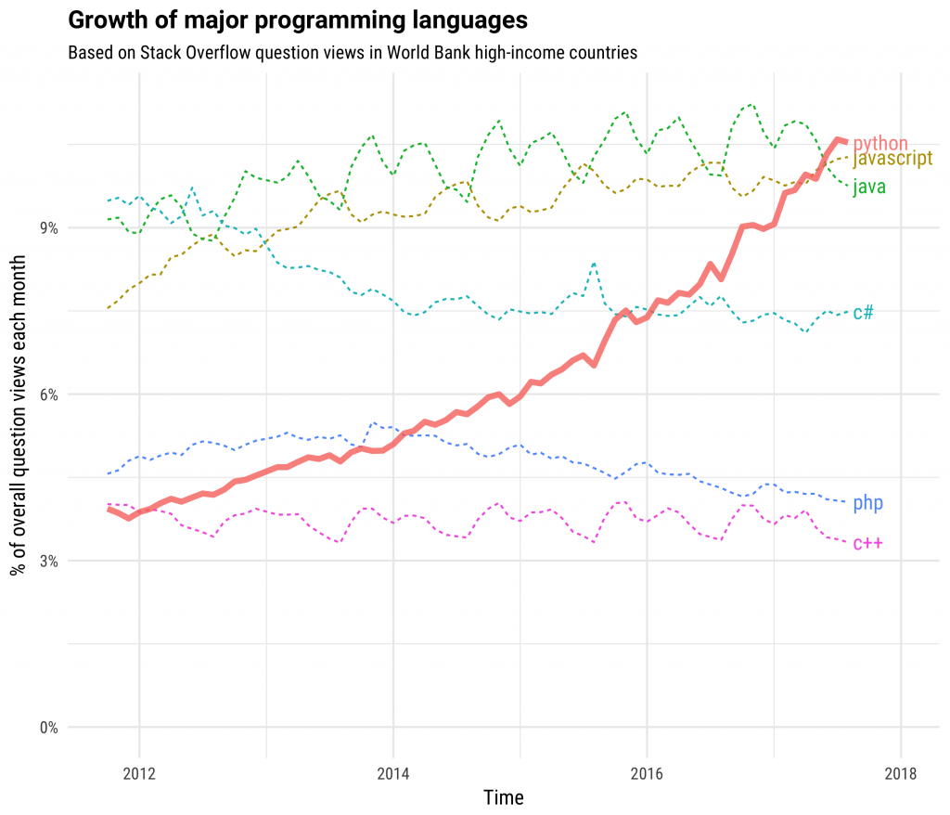
Python is popular
#1 language for Data Science, Machine Learning and Application building
Python is an “easy to learn”, powerful programming language. It has efficient high-level data structures and a simple but effective approach to object-oriented programming.
Python’s elegant syntax and dynamic typing, together with its interpreted nature, make it an ideal language for scripting and rapid application development in many areas on most platforms.
Who uses python?
Amazon, Google, Instagram, Uber, Netflix, Facebook, Instacart, basically everyone.

Slide 3
Goals and Objectives
Develop key programing skills with Python
Import/export data
Structure, Aggregate and shape data AKA – Wrangling Data
Graph, chart and visualize data
Manipulate strings and text , convert strings to numbers, and back
Perform Operations over Matrices
Apply conditional logic
Generate descriptive statistics
Apply common analytic transformations
Build visual applications
Author functions
80/20 Rule
80% of time is spent preparing data, 20% of time is spent analyzing.
Notes:
The thing that separates the analytic professionals from one another, is their skill in manipulating data across many platforms.
I think almost all of our exercises take advantage of real-world data. you’ll hear people often lament that 80% of their time is doing data preparation and 20% of their time is doing analysis, i think that is a little trite sound bite that software vendors like to throw around, yes a lot of time is spent manipulating data - you should spend your time manipulating it! The framework for data analysis that i use, and wish spelled something cute, boils down to a series of phases and i organize my programs around these phases:
Phase 1. Acquiring, Importing & Stage data
Phase 2. Structuring data (Sort, Aggregate, Join, Transpose)
Phase 3. Profile for Quality (Descriptive & Qualitative)
Phase 4. Cleansing & Transformation (also known as Feature engineering - ranges everything from missing value handling, clustering, pca, etc. )
Phase 5. Exploratory Data Analysis ( Descriptive, Univariate, Multivariate, etc)
Phase 6. Modeling & Validation
Phase 7. Integration
Phase 8. Monitoring
Phase 9. Rinse Repeat

Slide 4

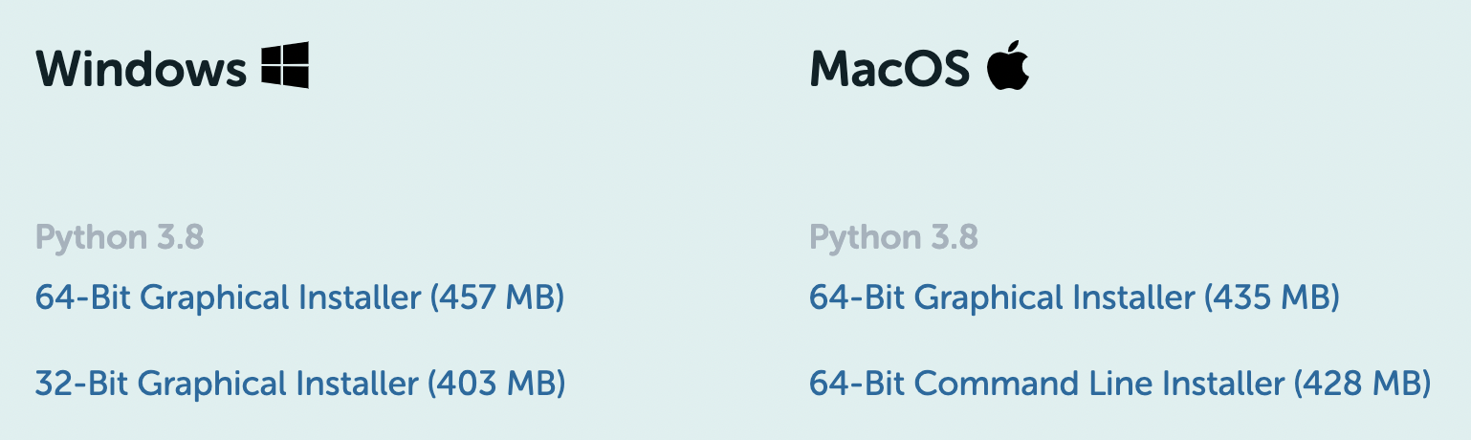
Setting up Python
Install the Anaconda Individual Edition:
https://www.anaconda.com/products/individual
installs more than 250 of the “most commonly used” open-source data science and machine learning packages are automatically installed, and thousands of others can be installed by simply typing conda install [package-name].
Most importantly it installs Jupyter Notebooks and Jupyter Lab

Slide 5
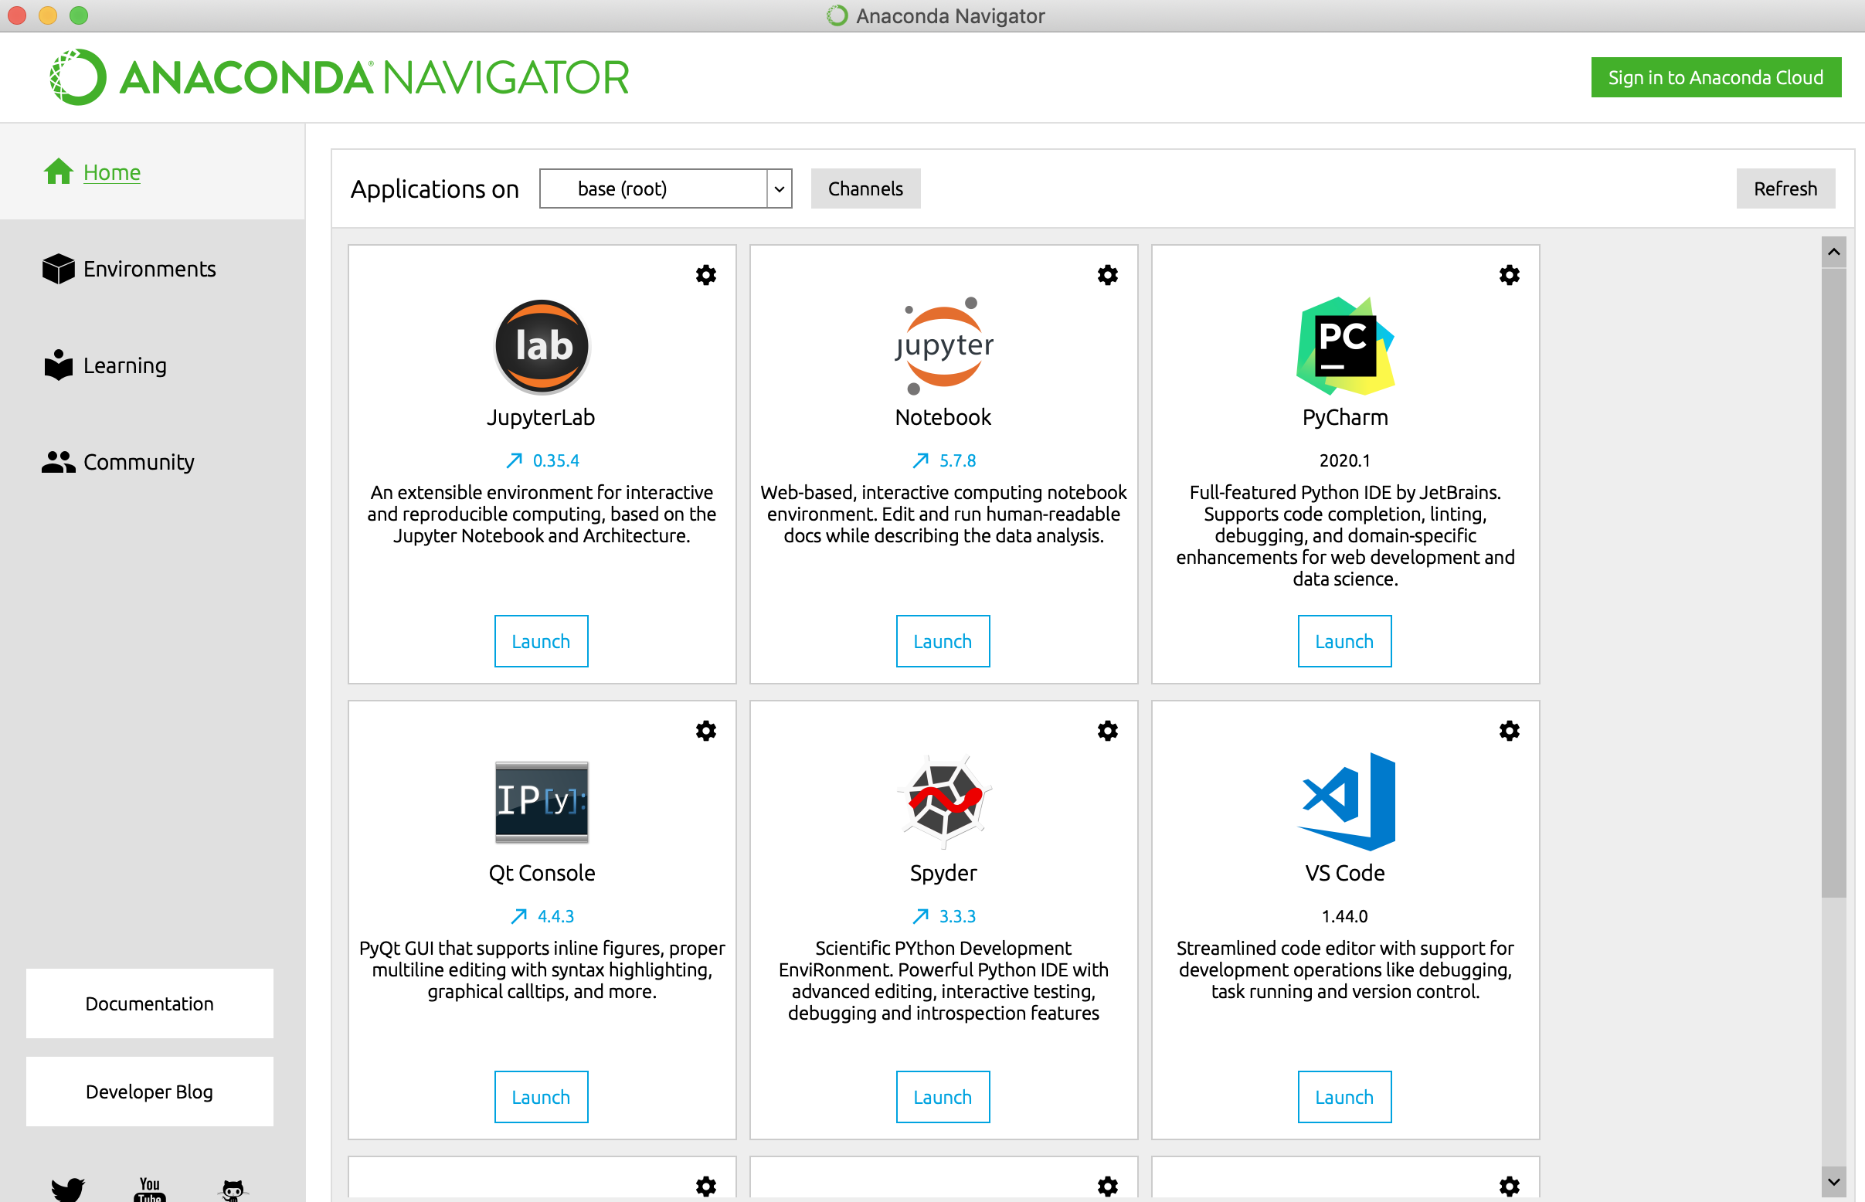
Anaconda Navigator

Slide 6
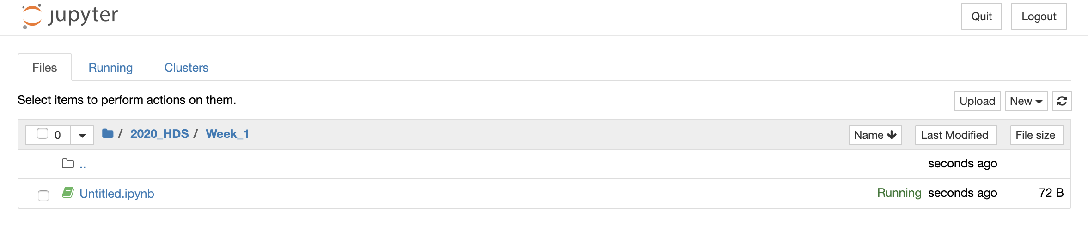
Jupyter Notebooks
Just points to a directory on your computer.
Step 1. make a folder for the class
Step 2. make a folder for the week
Step 3. create a notebook
New Notebook -> Python3

Slide 7
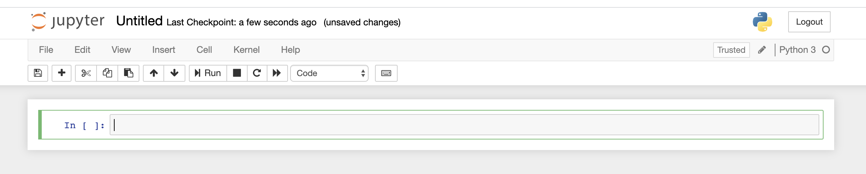
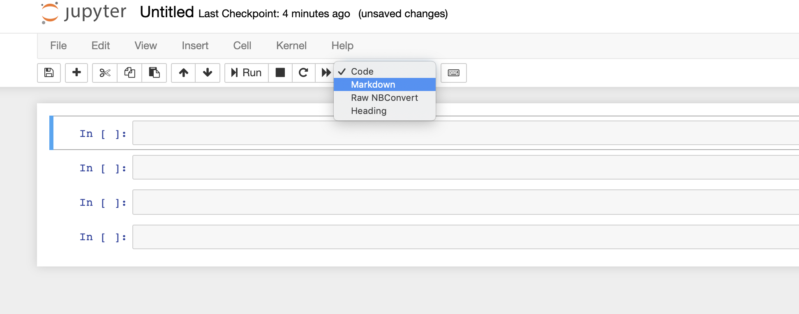
Your first Notebook
Notebook name, click and change it.
We’ll be using Code and Markdown Cells

Slide 8
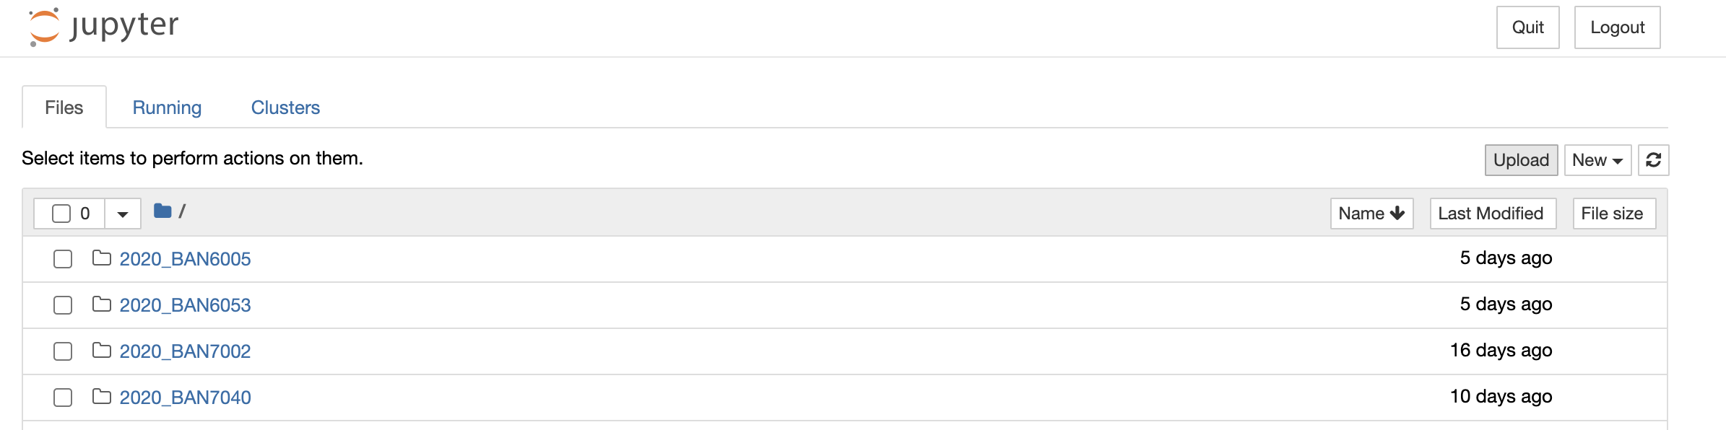
Upload a Notebook
From the course module download the 1_datatypes_notebook.ipynp
From your Jupyter notebook upload the notebook.
Alternatively, you can simply save the notebook in your Jupyter home directory.

Slide 9
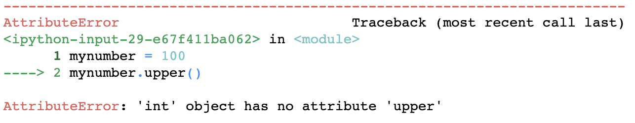
Python Variables & Types
Variables used to store a value.
Are case-sensitive: MyVariable is different than myvariable
Have an associated type (String, Boolean, Integer, Float, List, Dictionary) based on equal to
myfloat = 10.0 you can check with type(myfloat)
The “type” dictates the operations we can do on the variable
mystring = “this is a string variable”
mystring.upper()
[0] 'THIS IS A STRING VARIABLE'
mynumber = 100
mynumber.upper()
Error identifies the “line” causing the error and spits out a cryptic error message

Slide 10
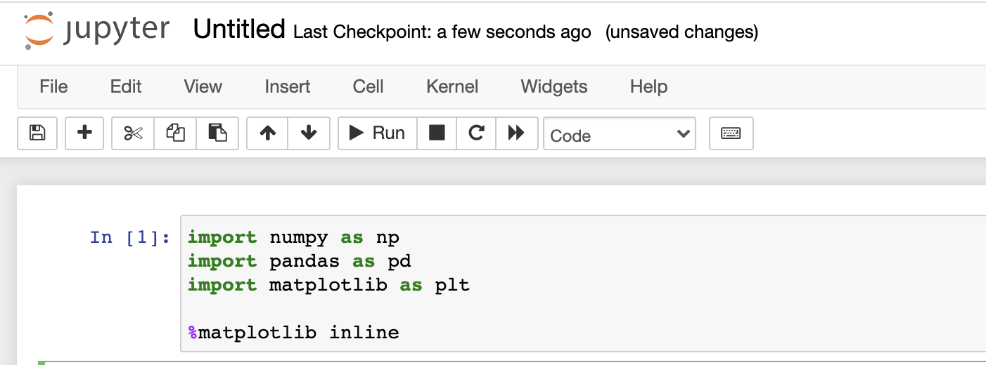
Quick and Dirty Python
Is it a library, a package or a module?
Libraries – “collection of related functions” you import a library to get access to the functions
The main libraries should have been installed when we installed Anaconda
Popular libraries / packages
Matplotlib – plotting and graphing
Numpy – “Numerical Pythohn” numeric computing via matrices, vectors, linear algebra, wicked fast
Pandas – tables, timeseries and functions to manipulate tables and timeseries
Sklearn – machine learning framework
Datetime - deal with dates and time data
Requests – make API calls
Install libraries via command line
>pip install pandas
>conda install pandas

Slide 11
Python
Datatypes
Data type | Example
str | x = “this is a string”
int | x = 100
float | x = 3.14
list | fruits = ["apple", "banana", "cherry"]
dict | employee = {"name" : "John", "age" : 36}
List reference
fruits[0] would return the first object in our case “apple”
List functions
fruits.append(“orange”) – append orange to end of list
fruits.count() – count items in the list
fruits.sort() – sort list
Dict reference – key: value pair
employee[“name”] would return “John”
Dict functions
employee.keys() return the “keys”, in our case both ”name” and “age”
employee. items() returns keys and values

Slide 12


Slide 13
Pandas
A DataFrame also known as a Table
Simply a Table with an index, rows and columns
df.loc[row_indexer, column_indexer]
Index | Column1 | Column2 | … | ColumnN
0
1
…
N
Row
Column

Slide 14
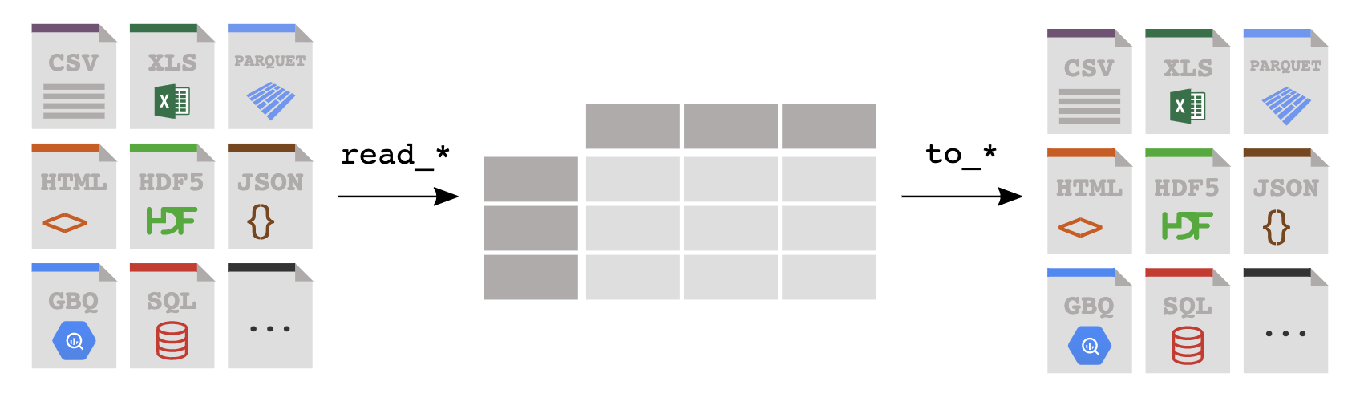
Pandas
Reading & Writing Data
Reading
df = pd.read_csv(‘myfile.csv’)
Rwrting
df.to_excel(‘myfile.xlsx’)
You read data from a file or database into a Pandas DataFrame, and you write from a DataFrame to a file or a database, the key is get data into Pandas!

Slide 15
Pandas
Series?
Think of it as a single column DataFrame
newSeries = df[“Column1”]
Series
Index | Column1 | Column2 | ColumnN
0
1
…
N
Index | Column1
0
1
…
N
=
> type(df[”Column1"])
% pandas.core.series.Series
https://pandas.pydata.org/pandas-docs/stable/reference/api/pandas.Series.html

Slide 16
Pandas
How do I “select specific columns”
Select specific ”columns” = [[ ]] – “bracket bracket”
newDataFrame = df[[ ”Column1”, “Column3”]]
DataFrame
Index | Column1 | Column2 | ColumnN
0
1
…
N
Index | Column1 | Column3
0
1
…
N
=
> type(df[”Column1"])
% pandas.core.frame.DataFrame
https://pandas.pydata.org/pandas-docs/stable/reference/api/pandas.DataFframe.html

Slide 17
Pandas
How do I “select specific rows?”
Select specific ”rows” =
queryResult = df[df[“Column1] == “value”]
DataFrame
Index | Column1 | Column2 | ColumnN
0
1
…
N
Index | Column1 | Column3
0
1
…
M
=
In [6]: type(df[”Column1"])
Out[6]: pandas.core.series.Series
https://pandas.pydata.org/pandas-docs/stable/reference/api/pandas.Series.html

Slide 18
Pandas
Conditional Operators
Pandas supports the common operator stuff
equal to: df[df[”column”] == “some_value”]
not equal to: df[df[”column”] != “some_value”]
greater than: df[df[”column”] > some_number ] (>,>=, <, M=)
In a list df[df[”column”].isin(a_list)]
use the squiggly “~” for not in a list, df[~df[”column”].isin(a_list)]
Multi-Conditions (&|)
AND: df[ (df[“column1” != “value”) & (df[“column2”] > some_nbr)]
OR : df[ (df[“column1” != “value”) | (df[“column2”] > some_nbr)]

Slide 19
Pandas
Useful functions
df.columns – returns a list of the names of the data frame’s columns
df.dtypes – provides the data types of your columns
df.info() – concise summary of dataframe
df.describe() – provides summary statistics of your DataFrame’s numeric columns
<class 'pandas.core.frame.DataFrame'>
RangeIndex: 3333 entries, 0 to 3332
Data columns (total 21 columns):
state 3333 non-null object
account_length 3333 non-null int64
area_code 3333 non-null int64
phone 3333 non-null object
 | count | mean | std | min | 0.25 | 0.5 | 0.75 | max
account_length | 3333 | 101.064806 | 39.822106 | 1 | 74 | 101 | 127 | 243
area_code | 3333 | 437.182418 | 42.37129 | 408 | 408 | 415 | 510 | 510
vmail_message | 3333 | 8.09901 | 13.688365 | 0 | 0 | 0 | 20 | 51

Slide 20
Pandas
df.query() a better way to filter rows …
Fast & readable queries for filtering rows.
Reference columns without quotes
Supports operators BUT concatenate conditions with “and”
df.query('area_code == "415" and \
intl_plan == "yes" and \
day_mins < 100 and \
state == ["WI", "OR", "WY"]')
state | area_code | phone | intl_plan | day_calls | state | day_mins | day_charge | eve_calls | eve_charge
WI | 415 | 355-7705 | yes | 92 | WI | 62.3 | 10.59 | 82 | 23.38
OR | 415 | 378-6772 | yes | 67 | OR | 12.5 | 2.13 | 90 | 21.81
WY | 415 | 412-3726 | yes | 117 | WY | 95.9 | 16.3 | 131 | 13.56

Slide 21
Pandas
df.query() reference
@ character identifies a variable to be evaluated rather than a column name, and lets you efficiently evaluate expressions.
mean_calls = df['day_calls'].mean()
state_list = ["WI", "OR", "WY"]
df.query('area_code == "415" and \
intl_plan == "yes" and \
day_calls < @mean_calls and \
state == @state_list')
state | area_code | phone | intl_plan | day_calls | state | day_mins | day_charge | eve_calls | eve_charge
OR | 415 | 332-9460 | yes | 87 | OR | 176.2 | 29.95 | 81 | 12.33
WI | 415 | 421-9401 | yes | 91 | WI | 264.3 | 44.93 | 115 | 13.68
WI | 415 | 355-7705 | yes | 92 | WI | 62.3 | 10.59 | 82 | 23.38
WY | 415 | 406-1349 | yes | 78 | WY | 189.6 | 32.23 | 117 | 22.73
WI | 415 | 339-6637 | yes | 97 | WI | 126.9 | 21.57 | 102 | 14.19

